Slide 1
Machine Learning AIML CZG565
M3 : Linear Models for Regression
Course Faculty of MTech Cluster
BITS – CSIS - WILP

Slide 2

Machine Learning
Disclaimer and Acknowledgement
The content for these slides has been obtained from books and various other source on the Internet
We here by acknowledge all the contributors for their material and inputs.
We have provided source information wherever necessary
Students are requested to refer to the textbook w.r.t detailed content of the presentation deck shared over canvas
We have reduced the slides from canvas and modified the content flow to suit the requirements of the course and for ease of class presentation
Source: “Probabilistic Machine Learning, An Introduction”, Kevin P. Murphy, Slides of Prof.Sugata, Prof. Chetana from BITS Pilani, Prof. Raja vadhana from BITS Pilani , CS109 and CS229 stanford lecture notes and many others who made their course materials freely available online.

Slide 3
Course Plan
M1 | Introduction
M2 | Machine learning Workflow
M3 | Linear Models for Regression
M4 | Linear Models for Classification
M5 | Decision Tree
M6 | Instance Based Learning
M7 | Support Vector Machine
M8 | Bayesian Learning
M9 | Ensemble Learning
M10 | Unsupervised Learning
M11 | Machine Learning Model Evaluation/Comparison

Slide 4
Agenda
Linear Model for Regression
Direct solution vs Iterative Method
Gradient Descent
Linear Basis Function
Notion of Bias vs Variance
Notes:
Machine Learning, Tom Mitchell
Read Chapter 1, 2 – Introduction to Machine Learning, 2nd edition, Ethem Alpaydin

Slide 5
Linear Regression

Slide 6
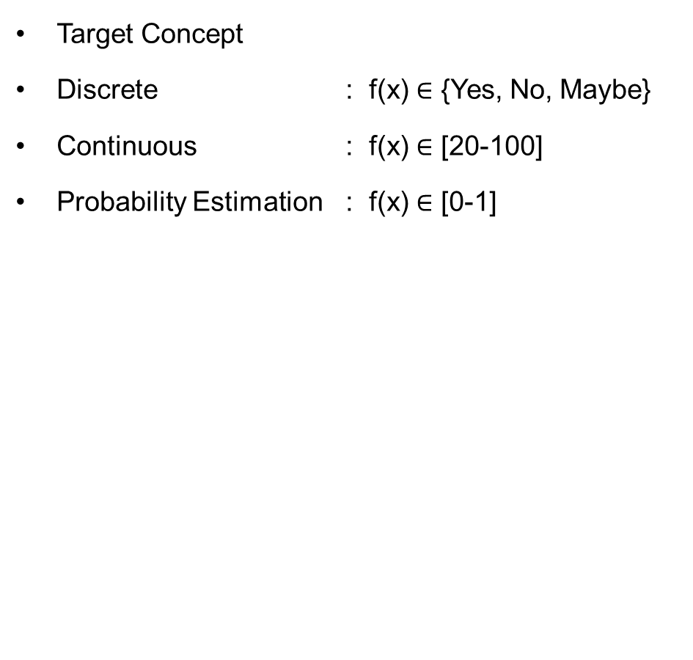
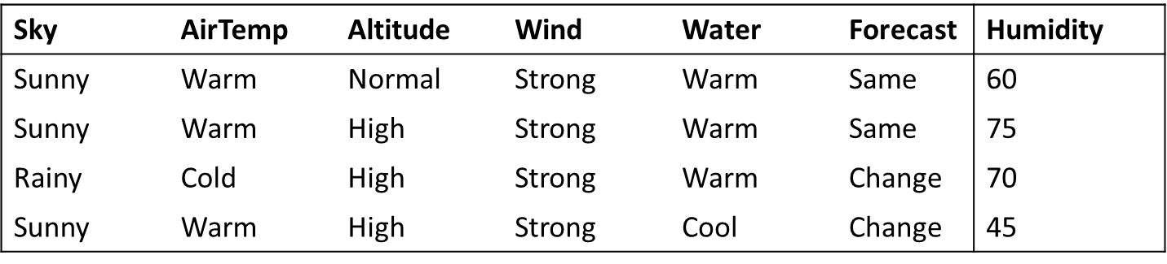
Inductive Learning Hypothesis : Interpretation
Classification
Regression

Slide 7




Formal Representation: Interpretation
Supervised Learning: Regression
GOAL : Previously unseen records should be assigned a value as accurately as possible.
Given (x₁, y₁), (x₂, y₂), ..., (x_{n}, y_{n})
Learn a function f (x) to predict y given x
– y is real-valued
9
8
7
6
5
4
3
2
1
0
1970 1980
September Arctic Sea Ice Extent (1,000,000 sq km)
1990
2000
2010
2020
Year Number

Slide 8
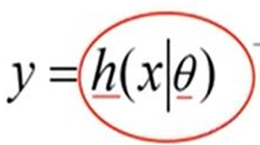
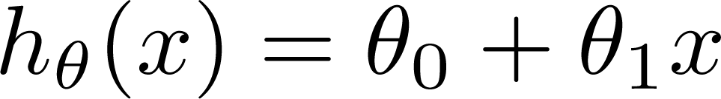

Machine Learning Process : Interpretation
Training Set
Price
(in 1000s of dollars)
Learning Algorithm
Size (feet²)
Size in feet² (x) | Price ($) in 1000's (y)
2104 | 460
1416 | 232
1534 | 315
852 | 178
… | …
Size of house
h
Estimated price
Hypothesis:
‘s : Parameters
h(.) : Model
How to choose ‘s ?

Slide 9
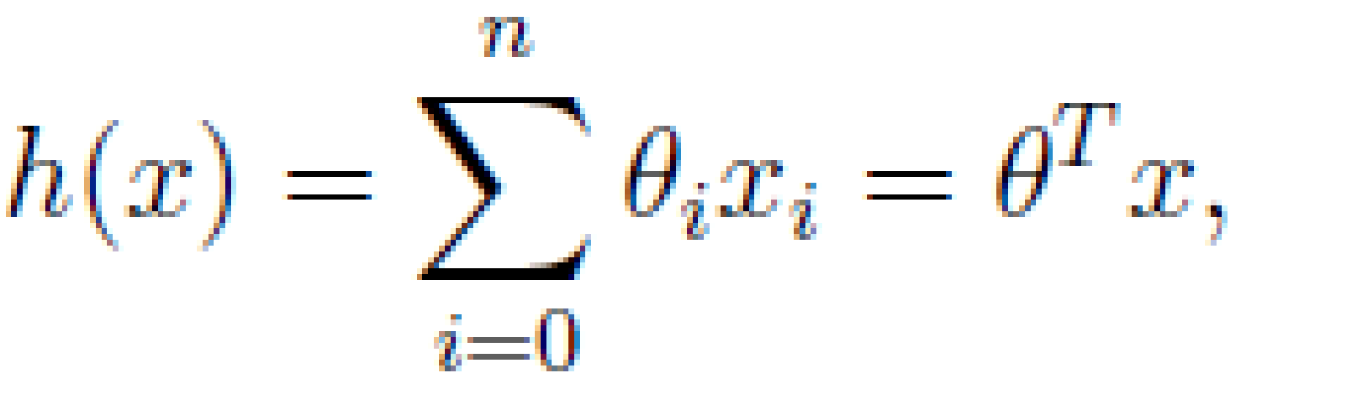
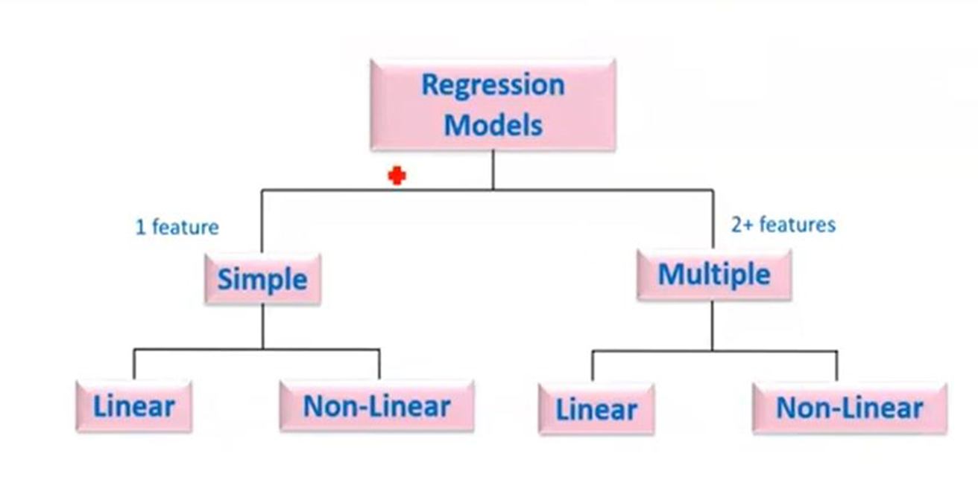
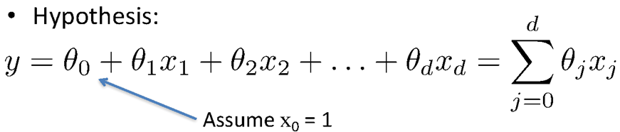
Types of Regression Models
Simple Linear regression model
(Education) x y (Income)
(Education) x₁
(Soft Skills) x₂
(Experience) x₃
(Age) x₄
Multiple Linear regression model
y (Income)

Slide 10

Learning the Model Parameters
Closed Form Solution Approach
Gradient Descent Approach

Slide 11
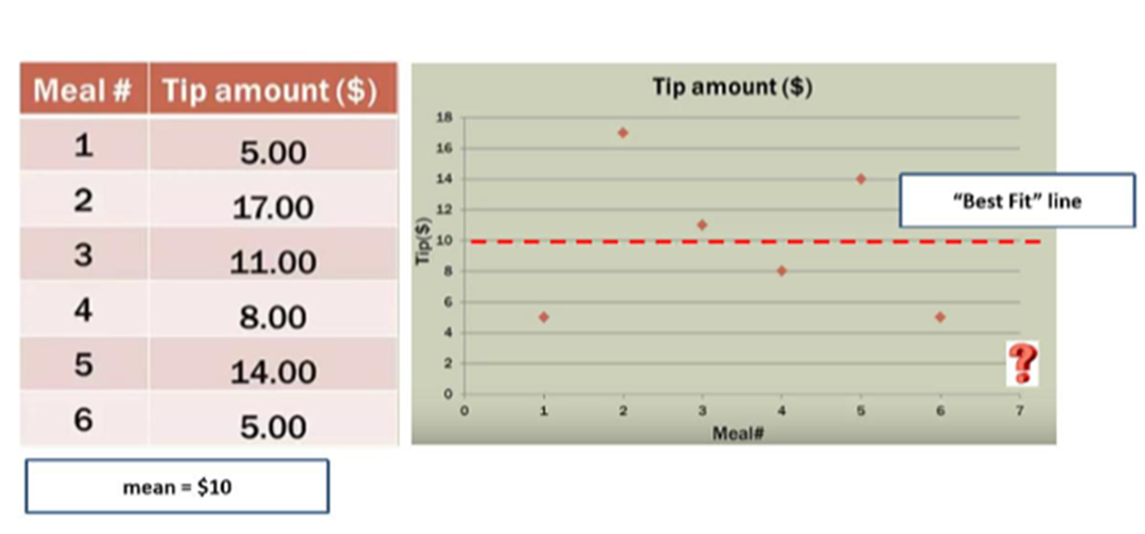
Notion of Cost Function
y = ɵ₀
y = ɵ₀

Slide 12
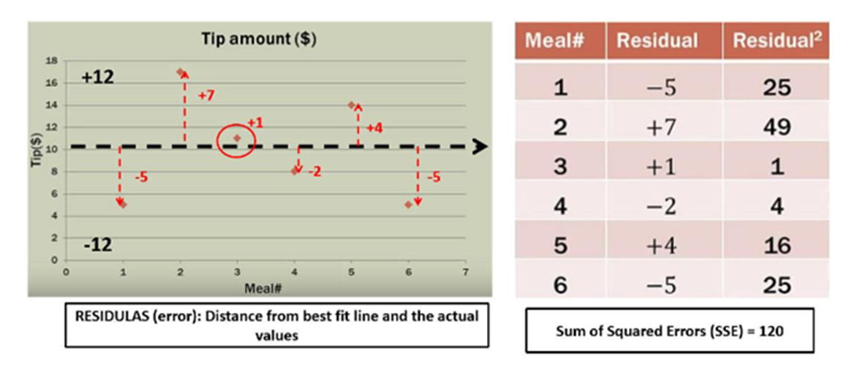
Notion of Cost Function

Slide 13
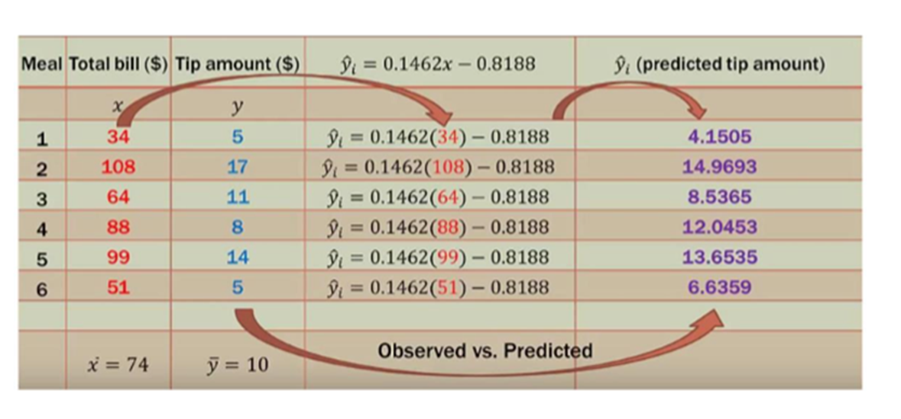
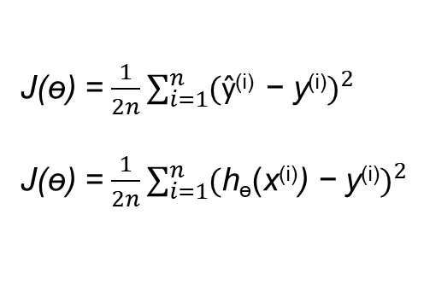
Notion of Cost Function
y = ɵ₀ + ɵ₁ x

Slide 14
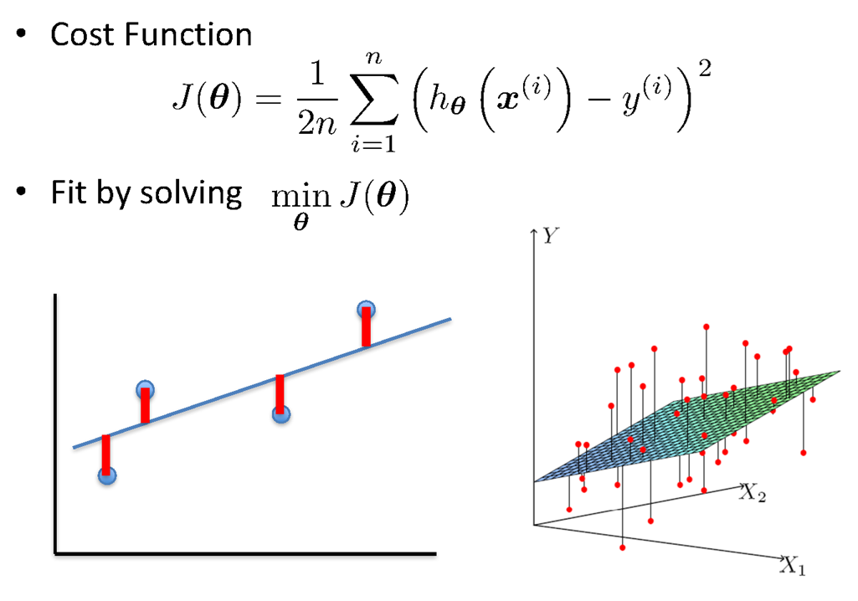
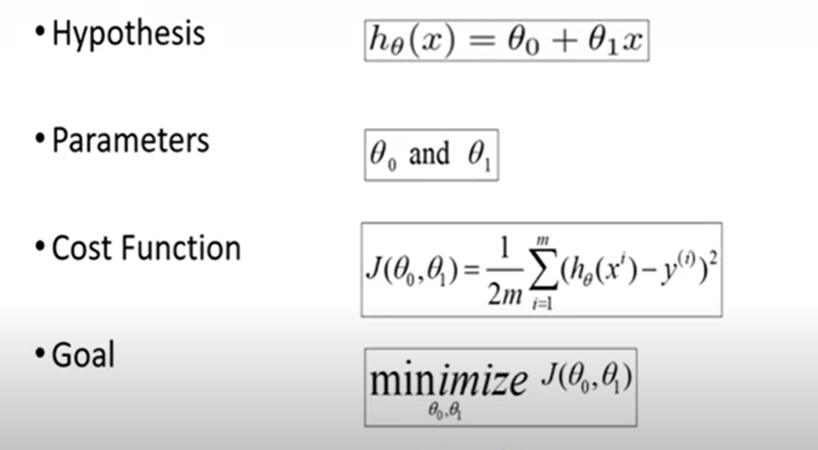
Linear Regression : Least Squares

Slide 15
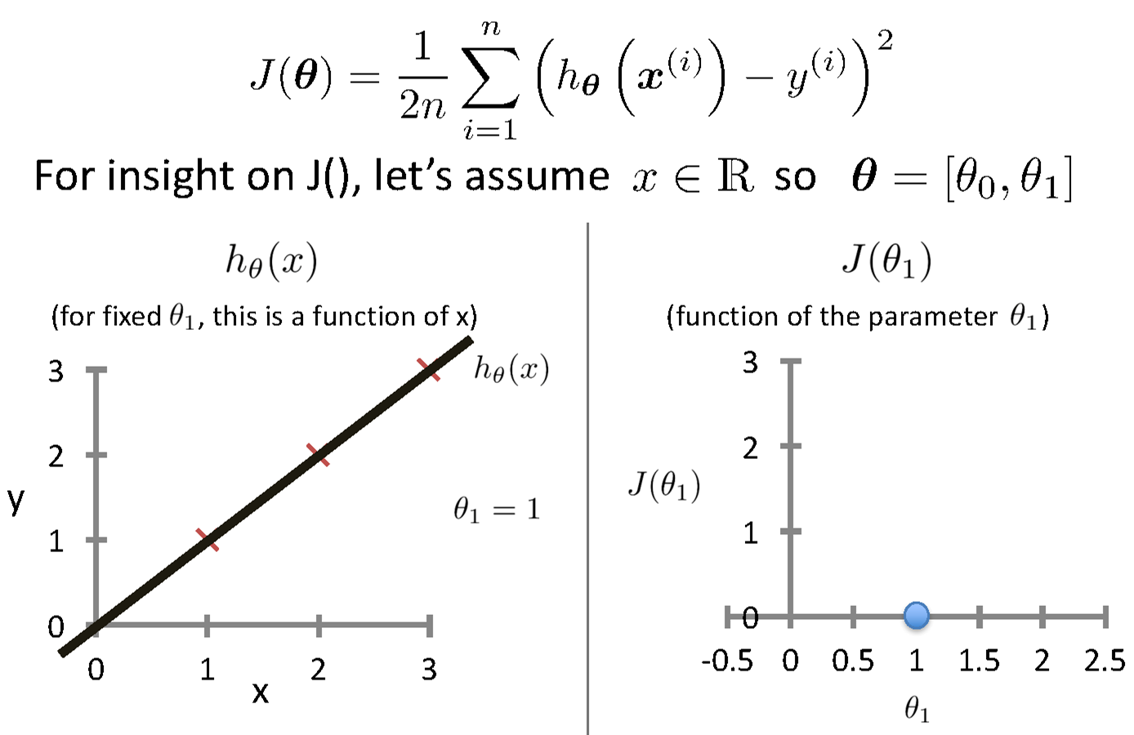

Intuition Behind Cost Function
Source Credit :

Slide 16
Intuition Behind Cost Function
Source Credit :

Slide 17
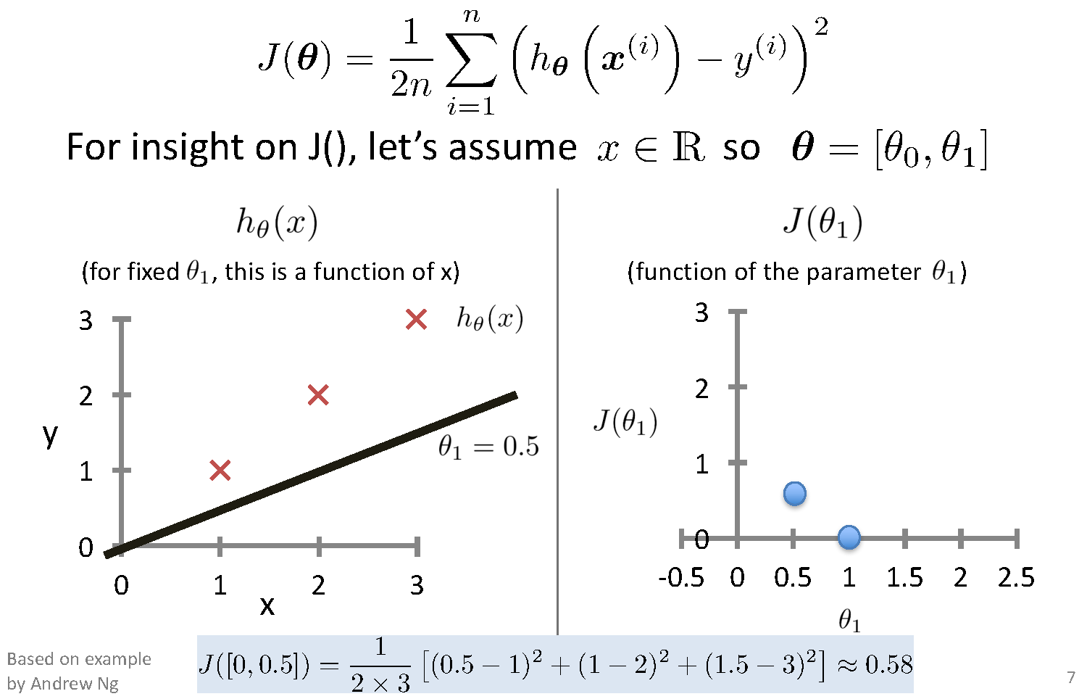
Intuition Behind Cost Function

Slide 18
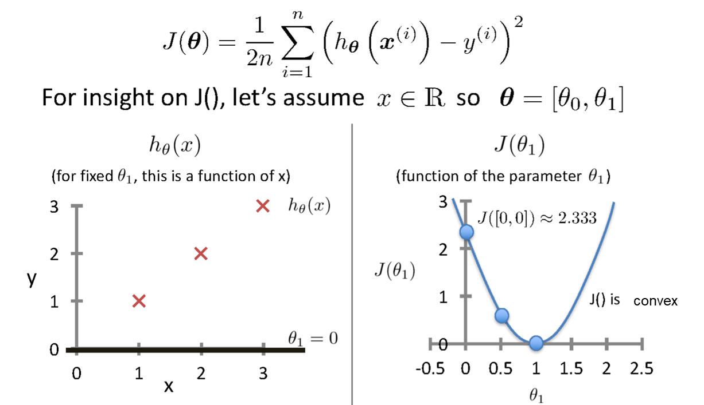
Intuition Behind Cost Function
Source Credit :

Slide 19
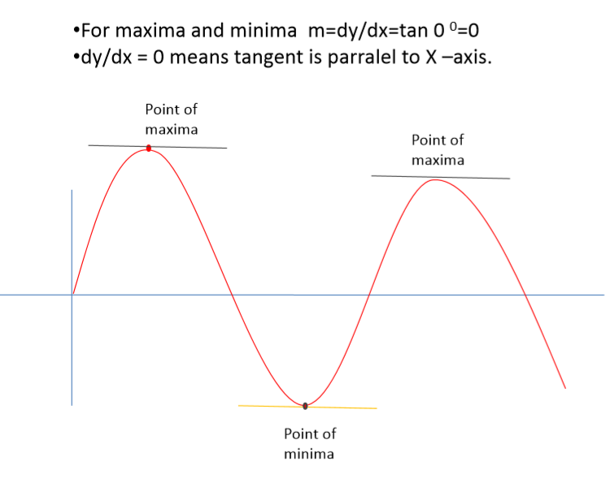
Notion of Maxima and Minima of a function
In General

Slide 20
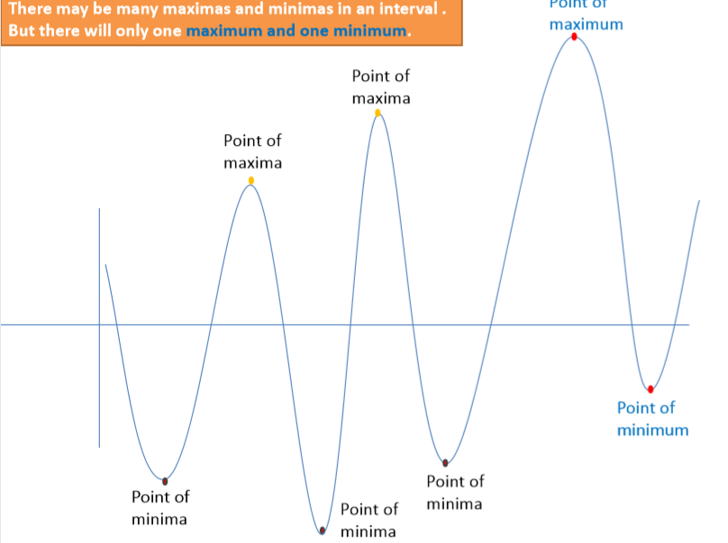
Notion of Maxima and Minima of a function
In Machine Learning
CarPrice = 1 + 0.05Mileage
CarPrice = 1 + 0.25Mileage
CarPrice = 1 + 0.75Mileage
15.7
15.3
Weight of Mileage
Mileage (in kmpl) | Car Price (in cr)
9.8 | 10.48
9.12 | 1.75
9.5 | 6.95
10 | 2.51
12.4
Sum of absolute Error
/ Training Error

Slide 21
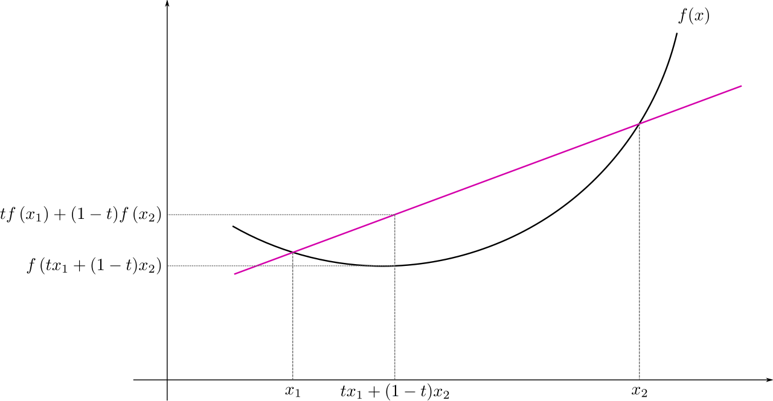
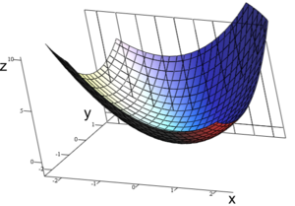
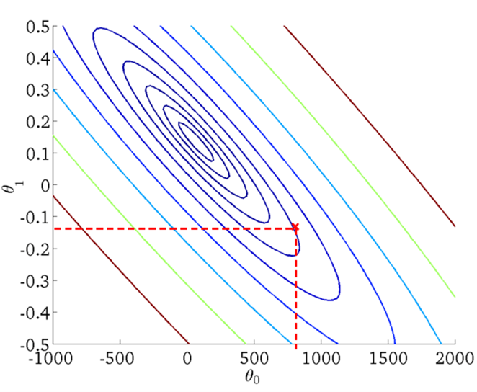
: Multivariate View
Convex Function
Real-valued function defined on an n-dimensional interval is called convex if the line segment between any two points on the graph of the function lies above or on the graph

Slide 22
Closed Form Solution

Slide 23
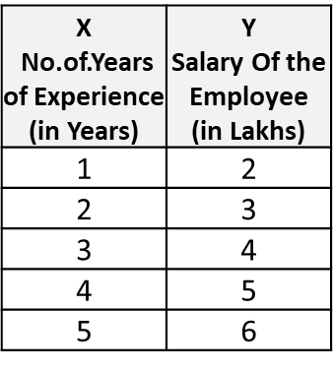
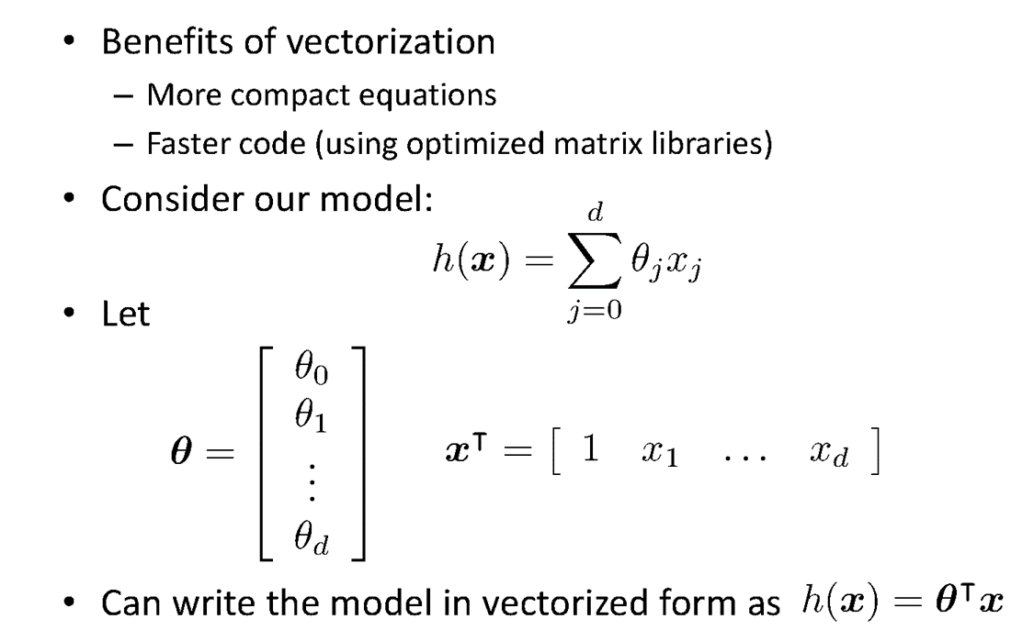
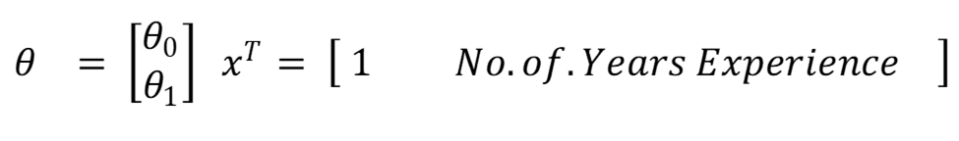
Vectorization

Slide 24
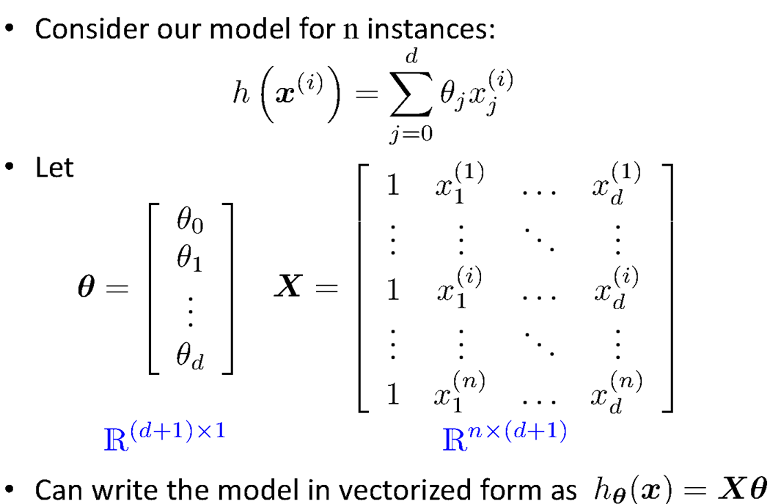
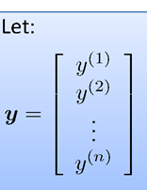
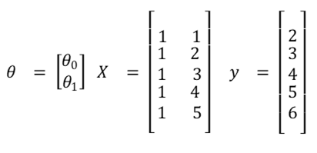
Vectorization

Slide 25
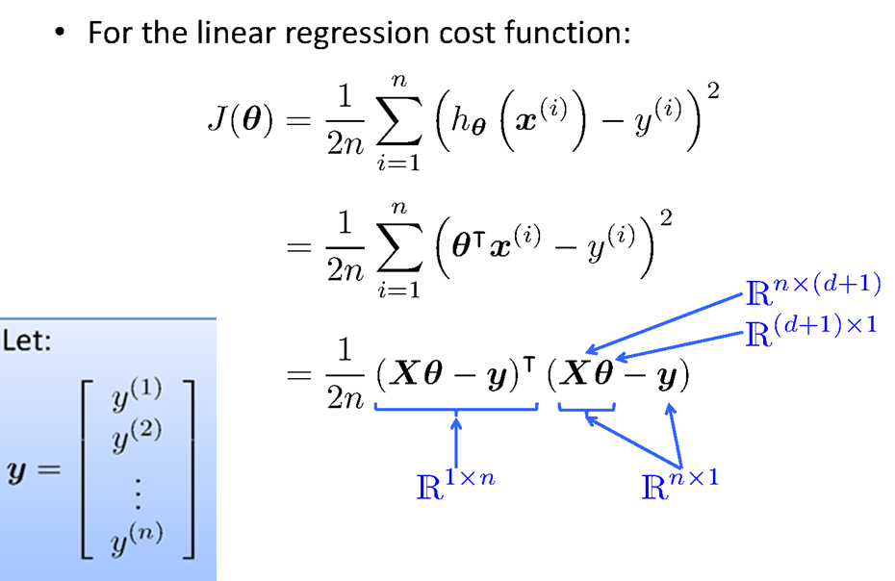
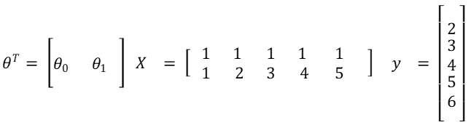
Vectorization

Slide 26
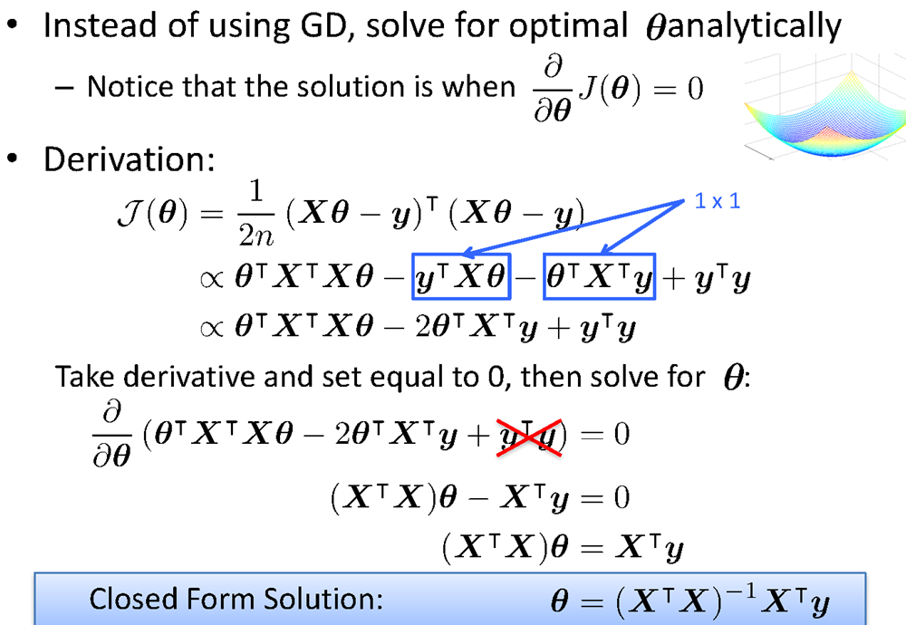
Vectorization

Slide 27
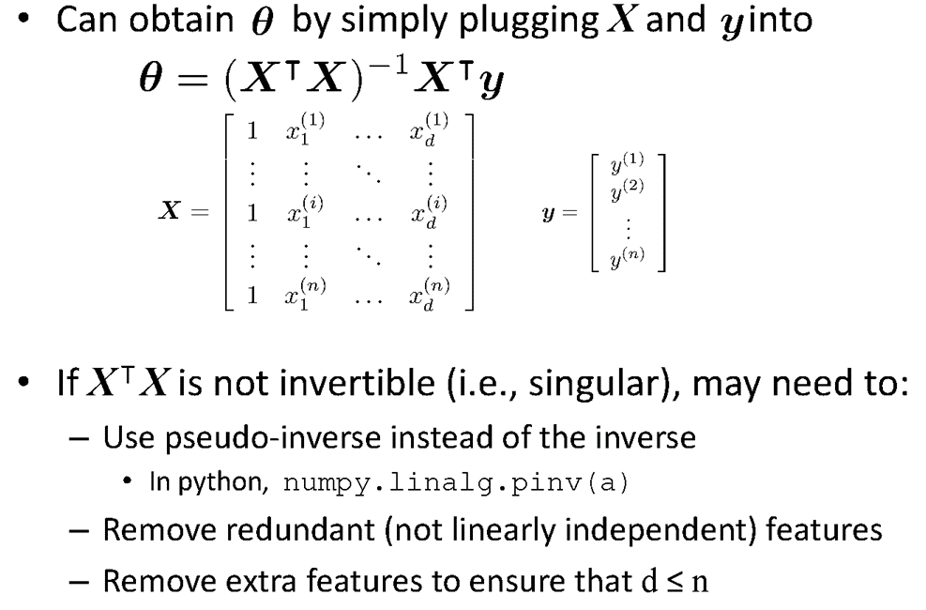
Vectorization

Slide 28
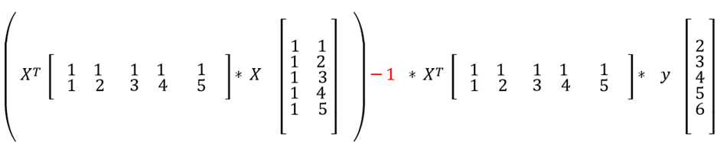
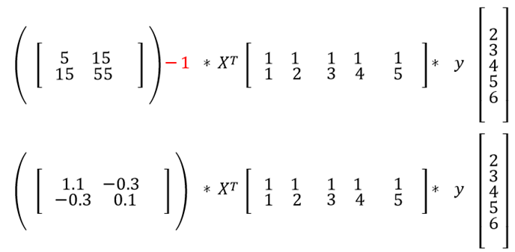
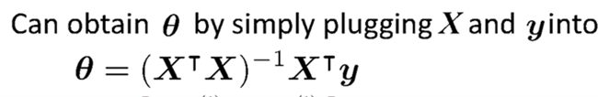
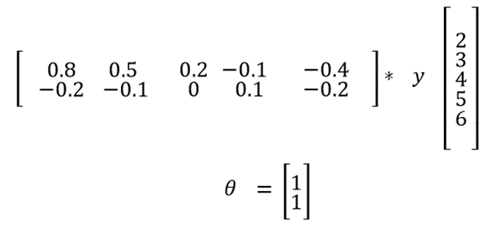
Fit the Linear Regression Model :
Using Closed Form – Problem Type 1

Slide 29
Gradient Descent Approach

Slide 30
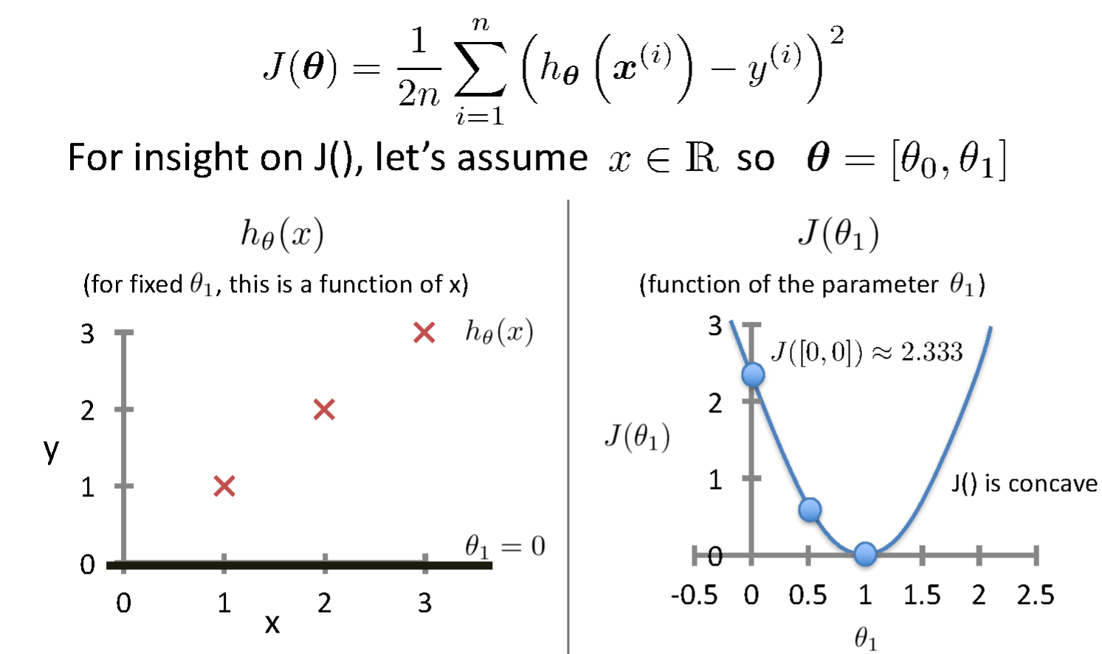
Intuition Behind Cost Function
Source Credit :

Slide 31
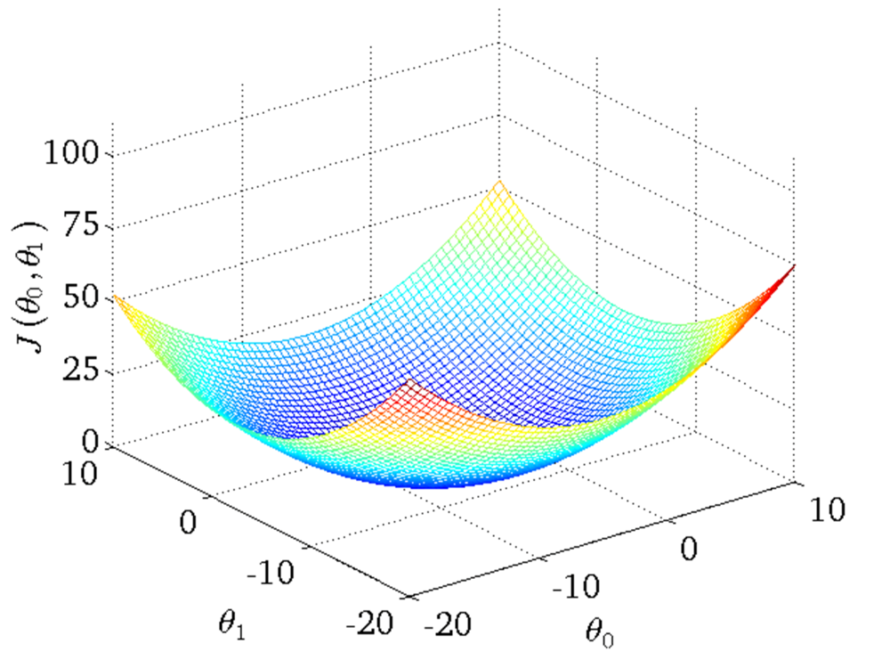
Intuition Behind Cost Function
Source Credit :

Slide 32
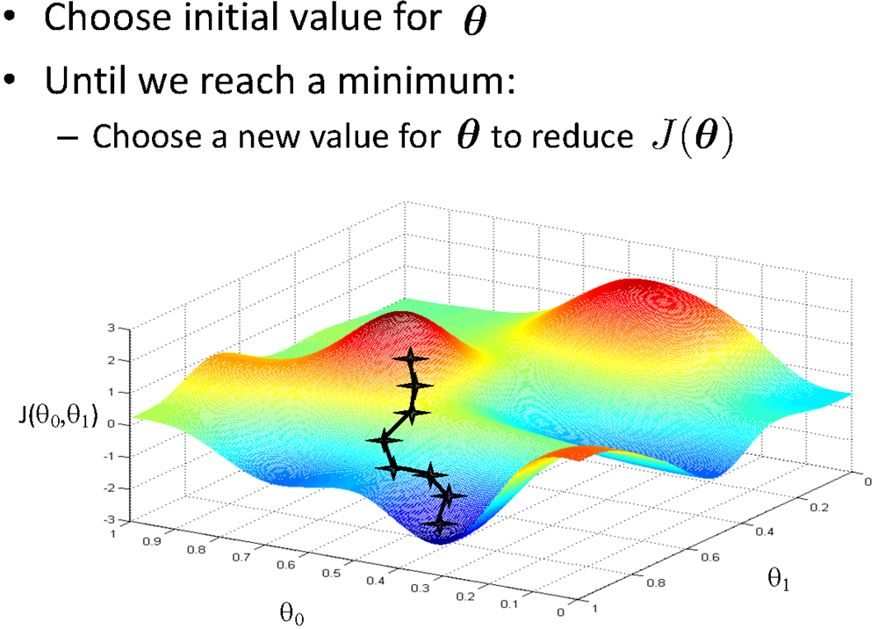
Basic Search Procedure
Source Credit : Figure by Andrew Ng

Slide 33
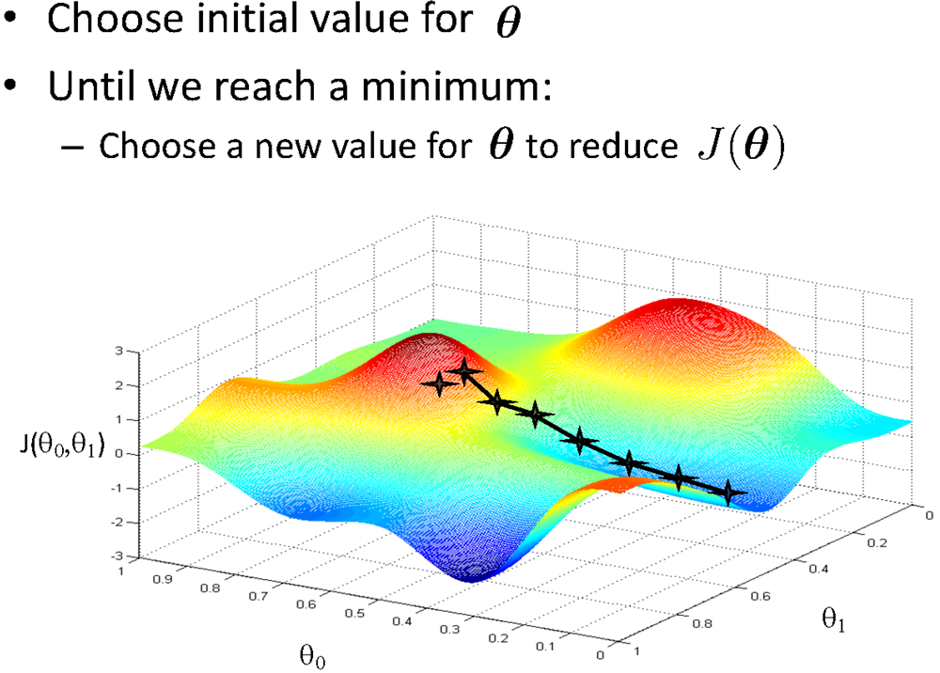
Basic Search Procedure
Source Credit : Figure by Andrew Ng

Slide 34
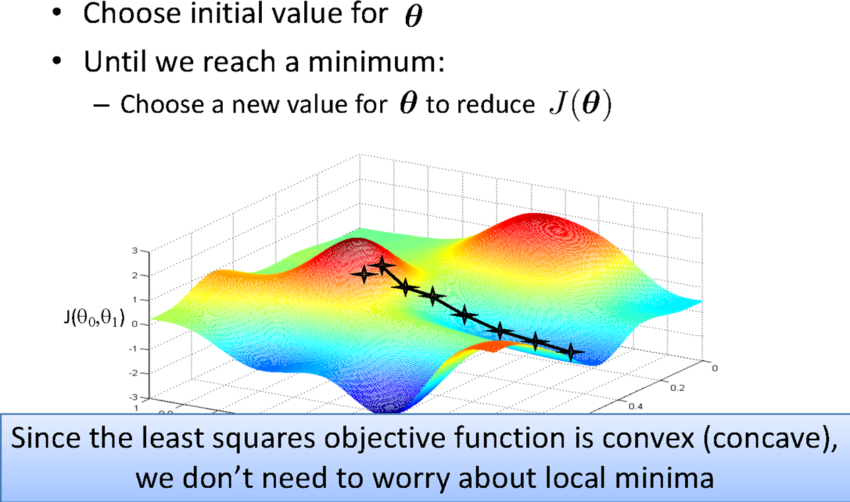
Basic Search Procedure
Source Credit : Figure by Andrew Ng

Slide 35
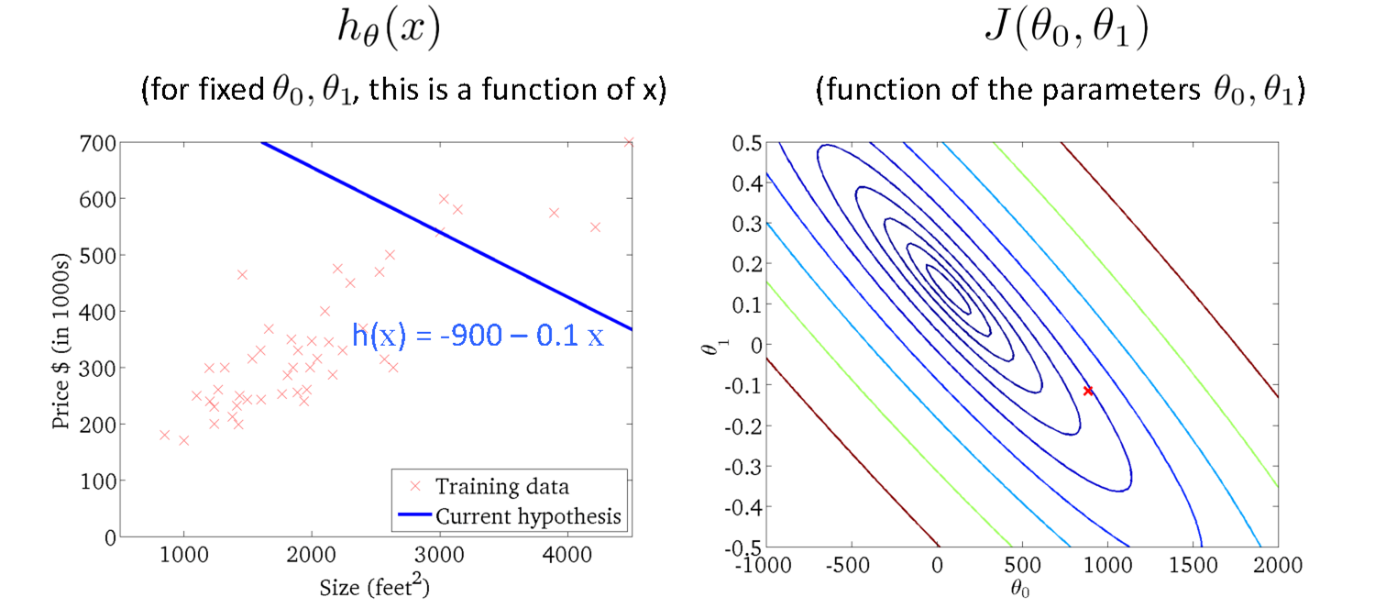
Size in feet² (x) | Price ($) in 1000's (y)
2104 | 460
1416 | 232
1534 | 315
852 | 178
… | …
Gradient Descent
Source Credit : Slide by Andrew Ng

Slide 36
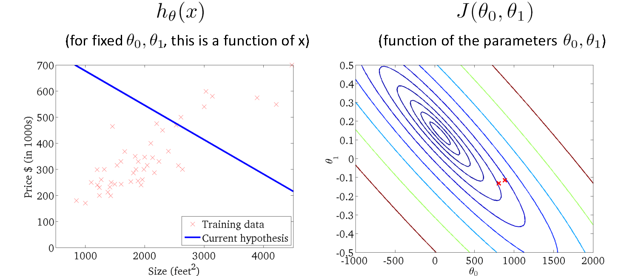
Gradient Descent
Source Credit : Slide by Andrew Ng

Slide 37
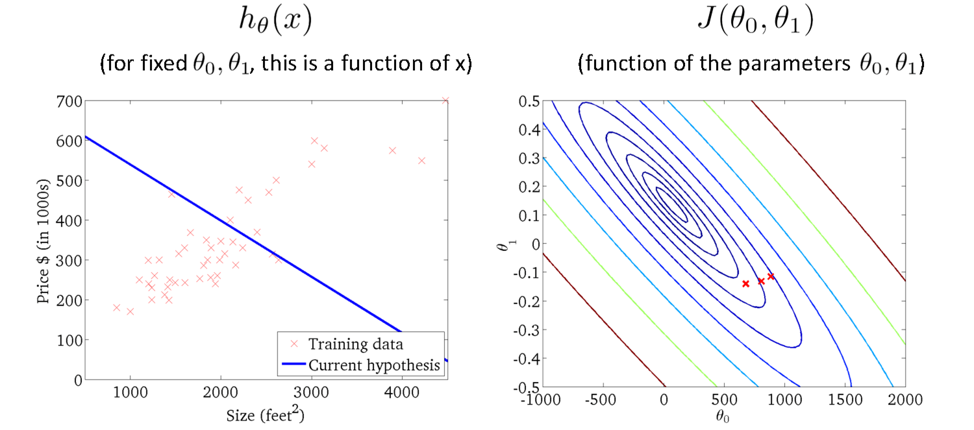
Gradient Descent
Source Credit : Slide by Andrew Ng

Slide 38
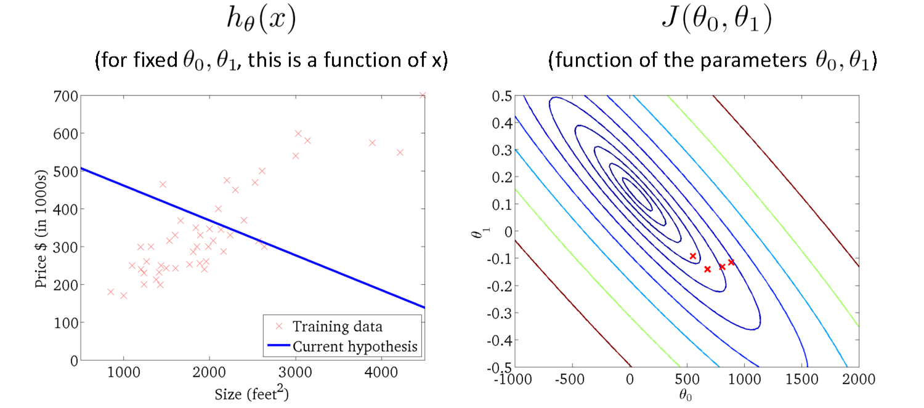
Gradient Descent
Source Credit : Slide by Andrew Ng

Slide 39
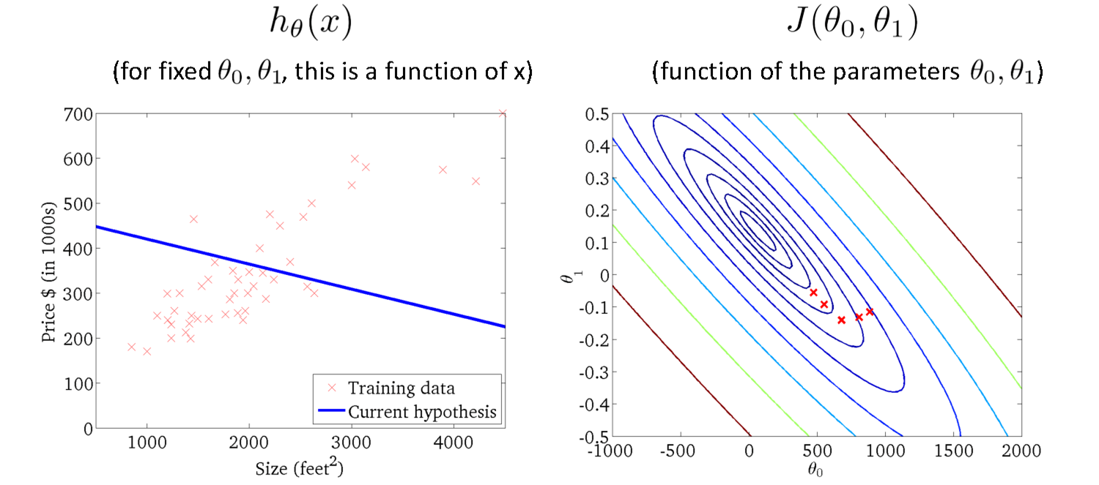
Gradient Descent
Source Credit : Slide by Andrew Ng

Slide 40
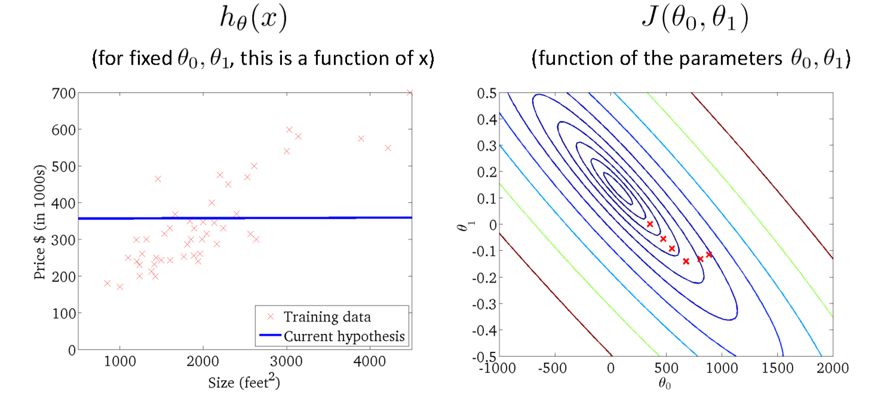
Gradient Descent
Source Credit : Slide by Andrew Ng

Slide 41
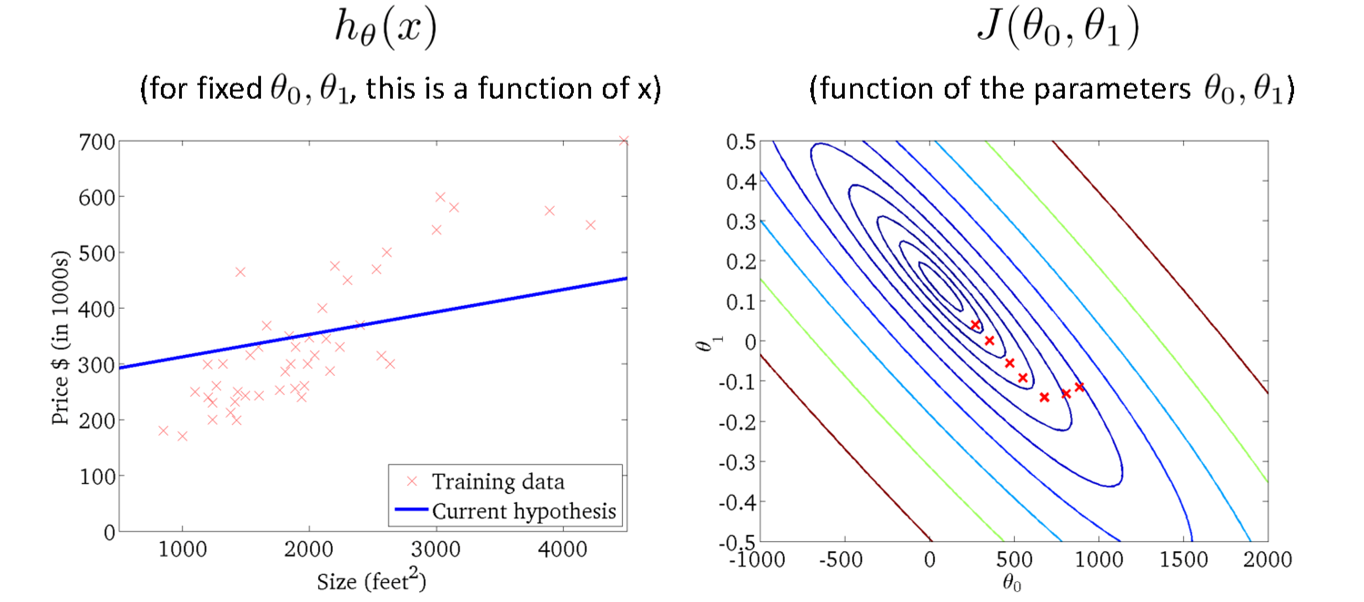
Gradient Descent
Source Credit : Slide by Andrew Ng

Slide 42
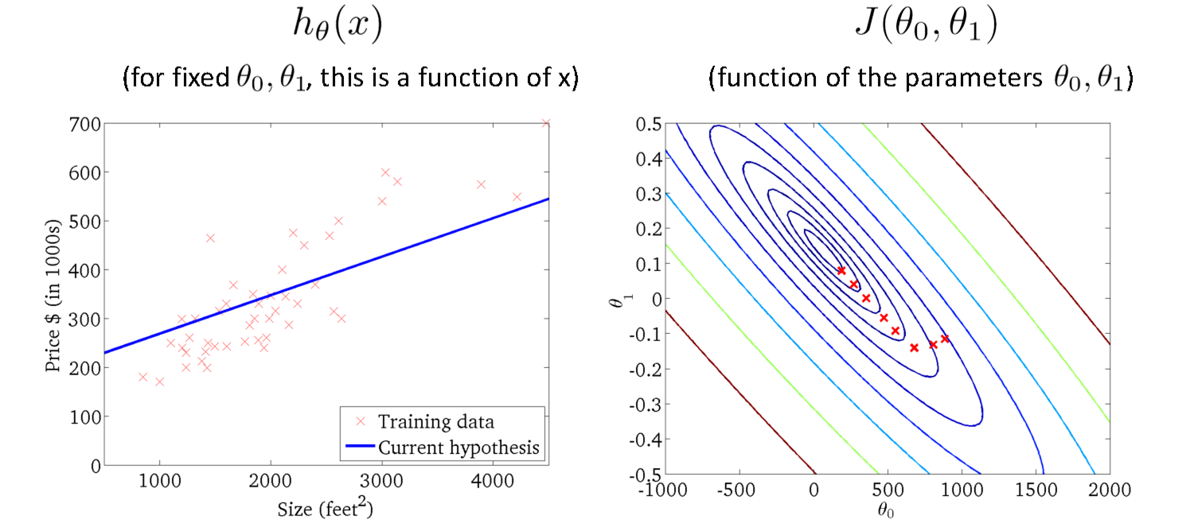
Gradient Descent
Source Credit : Slide by Andrew Ng

Slide 43
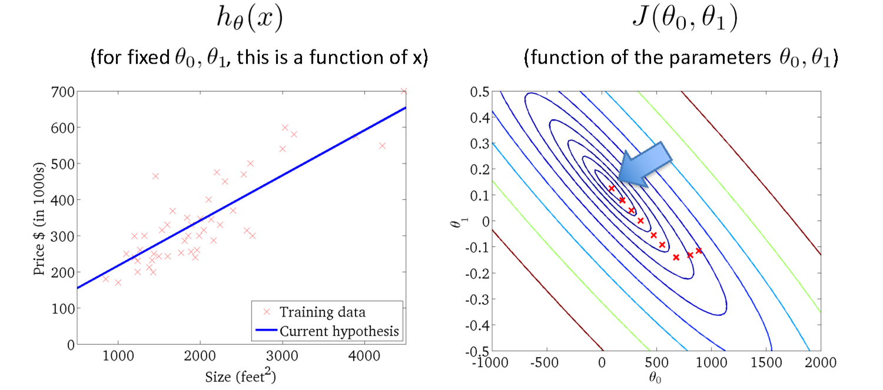
Gradient Descent
Source Credit : Slide by Andrew Ng

Slide 44
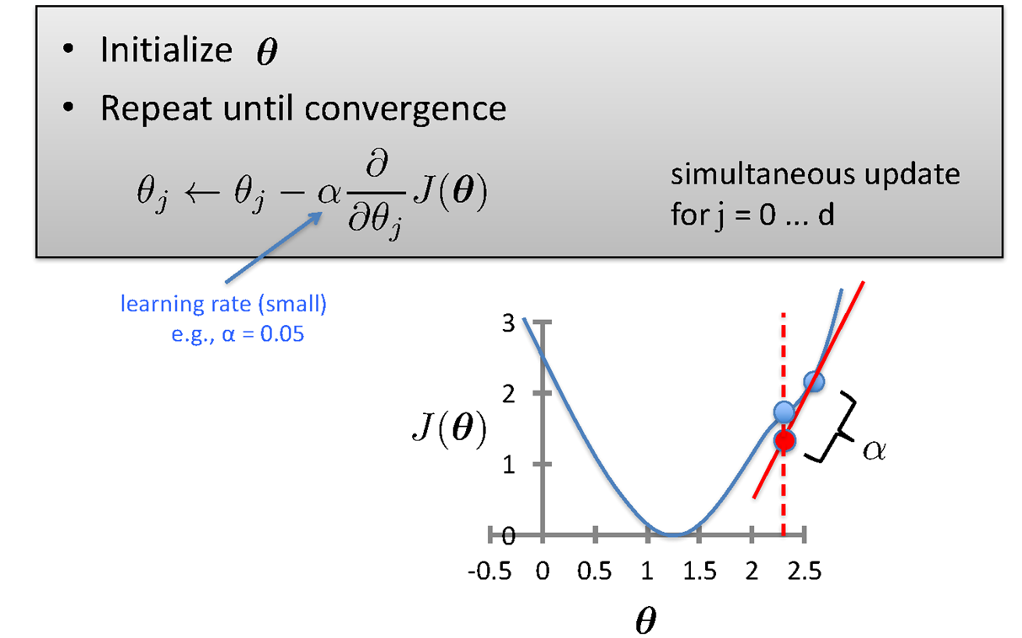
Gradient Descent

Slide 45

Gradient Descent

Slide 46

Gradient Descent for Linear Regression

Slide 47






Guarantee of Convergence
Positive Derivative
𝞱₁
𝞱₁
𝞱₁
New 𝞱₁
Old 𝞱₁
Source Credit: Prof. Mohammad Hammoud

Slide 48



Guarantee of Convergence
Negative Derivative
𝞱₁
𝞱₁
𝞱₁
Old 𝞱₁
New 𝞱₁
Source Credit: Prof. Mohammad Hammoud

Slide 49

Choosing Learning Rate

Slide 50

Gradient Descent algorithm : Effect of Feature Scaling

Slide 51

Gradient Descent algorithm : Effect of Learning Rate :
Problem Type 2 – Interpretation of Convergence or Effect of Hyper parameters

Slide 52
Fit a linear Regression Line : Gradient Descent : Problem Type 3
Steps :
(Assuming : ‘n’ no.of.instances and two predictors {x1, x2} and linear regression)
Identification of the equations y = w0+w1X1+W2X2
Cost function & derivative
W0` = w0 – 1/n * learning rate * (sum (w0+w1X1+W2X2 - y))
W1` = w1 – 1/n * learning rate * (sum (w0+w1X1+W2X2 - y) * x1)
W2` = w2 – 1/n * learning rate * (sum (w0+w1X1+W2X2 - y)*x2)
Apply the equations

Slide 53

Fit a linear Regression Line : Gradient Descent
Fit a linear regression. Show only the first iteration of Gradient descent algorithm using learning rate of 0.02 for the following data , if the Relative Risk of Coronary Heart Disease is believed to be only linearly dependent on BMI as well as Diastolic Pressure. Assume the intercept of the regression model as 5 and the slope of independent variables as -0.03 (negative).
Steps :
Identification of the equations y = w0+w1X1+W2X2
Cost function & derivative
W0` = w0 – 1/3 * learning rate * (sum (w0+w1X1+W2X2 - y))
W1` = w1 – 1/3 * learning rate * (sum (w0+w1X1+W2X2 - y) * x1)
W2` = w2 – 1/3 * learning rate * (sum (w0+w1X1+W2X2 - y)*x2)
Apply the equations

Slide 54
Fit a linear Regression Line : Gradient Descent
Fit a linear regression. Show only the first iteration of Gradient descent algorithm using learning rate of 0.02 for the following data , if the Relative Risk of Coronary Heart Disease is believed to be only linearly dependent on BMI as well as Diastolic Pressure. Assume the intercept of the regression model as 5 and the slope of independent variables as -0.03 (negative).
Steps :
Identification of the equations: RR-CHD = 5 – 0.03 * BMI – 0.03 * DiastolicPressure
Cost function & derivative
W0` = w0 – 1/3 * 0.02 * (sum (5-0.03BMI-0.03DiastolicPresure - RRCHD))
= 5 – 1/3 * 0.02 * (sum (5-0.03BMI-0.03DiastolicPresure - RRCHD))
W1` = w1 – 1/3 * 0.02 * (sum (5-0.03BMI-0.03DiastolicPresure - RRCHD) * BMI)
= -0.03 – 1/3 * 0.02 * (sum (5-0.03BMI-0.03DiastolicPresure - RRCHD) * BMI)
W2` = w2 – 1/3 * 0.02 * (sum (5-0.03BMI-0.03DiastolicPresure - RRCHD) * DiastolicPresure)
= -0.03 – 1/3 * 0.02 * (sum (5-0.03BMI-0.03DiastolicPresure - RRCHD) * DiastolicPresure)
Apply the equations : Answer at the end of first iteration:
W0 = 5.0016 , W1 = 0.0476, w2= 0.179

Slide 55

Closed Form Solution Vs. Gradient Descent

Slide 56
Types of Gradient Descent Algorithms

Slide 57

Gradient Descent: Variants
Batch gradient descent refers to calculating the derivative from all training data before calculating an update.
Minibatch refers to calculating derivative of mini groups of training data before calculating an update.
Stochastic gradient descent refers to calculating the derivative from each training data instance and calculating the update immediately

Slide 58

Gradient Descent: Variants

Slide 59

Gradient Descent: Variants

Slide 60

Gradient Descent: Variants

Slide 61


Gradient Descent: Variants - Effect on Convergence

Slide 62
Evaluation Metrics

Slide 63




Evaluation of Linear Regression Model
Mileage (in kmpl) | Car Price (in cr)
9.8 | 10.48
9.12 | 1.75
9.5 | 6.95
10 | 2.51
…. | …..
Unseen Data
Mileage (in kmpl) | Car Price (in cr)
7.5 | 9.25
10 | 6.5
…. | …..
Model 1
CarPrice = 8.5 + 0.5 Mileage – 1.5 Mileage²
Model 2
CarPrice = -5.5 + 1.5 Mileage

Slide 64

Evaluation of Linear Regression Model R-squared
variation in ‘y’ that is explained by a regression model
Mileage (in kmpl) | Car Price (in cr)
9.8 | 10.48
9.12 | 1.75
9.5 | 6.95
10 | 2.51
…. | …..
Car Price (in cr)
10.48
1.75
6.95
2.51
Mean Y
variation in ‘y’ that is not captured/explained by a regression model
Model 1
CarPrice = 8.5 + 0.5 Mileage – 1.5 Mileage²
variation that is explained by a regression model
measures the goodness of fit of a regression model

Slide 65
Linear Basis Models
What if output is a non-linear function of input vector?

Slide 66




Polynomial Regression
17 / 22

Slide 67





Linear Basis Function Models

Slide 68



Linear Basis Function Models
Example: an M-th order polynomial function of one dimensional feature x :
where x^{j} = j-th power of x
Φ_{j}(x) are known as basis functions. Typically, Φ₀(x) = 1, so that w₀ acts as a bias.
In the simplest case, we use linear basis functions : Φ_{d}(x) = x_{d}.
They are called linear models because this function is linear in w.

Slide 69







Linear Basis Function Models - Examples

Slide 70
Notion of Bias - Variance

Slide 71

Quality of Fit

Slide 72

Handling Overfitting – Way 1
Increase in Size of the data set reduces the over-fitting problem

Slide 73


Effect of Training Size on Over fitting Problem Type 4 : Interpretation of the Model Fit
Size of training dataset needs to be large to prevent when higher order model is used.
Higher order model
Lower order model

Slide 74

Polynomial Fitting can lead to Overfitting
Handling Overfitting – Way 2 – Reduce the complexity of the model
Underlying target function is quadratic
Linear model results in under fitting with large bias
Polynomial of order 300 results in a large variance

Slide 75

How to experiment on Model Complexity ?

Slide 76

Handling Overfitting – Way 3
Early Stop the Training

Slide 77
Regularization (*This notion is common for both Linear Regression – Module 3 and Logistic Regression – Module 4)

Slide 78

Overfitting vs Underfitting
Overfitting
Underfitting
Fitting the data too well
Features are noisy / uncorrelated to concept
Learning too little of the true concept
Features don’t capture concept
Too much bias in model

Slide 79

Regularization

Slide 80

Regularization

Slide 81

Understanding Regularization

Slide 82

Understanding Regularization

Slide 83

Understanding Regularization

Slide 84


Regularization
Ridge Regression / Tikhonov regularization

Slide 85




Regularization
Lasso Regression (Least Absolute Shrinkage and Selection Operator Regression)

Slide 86



Regularization
Elastic Net
+ r
Control the regularization using the Mix Ration “r”:
When,
r = 0, Elastic Net is equivalent to Ridge Regression,
r = 1, it is equivalent to Lasso Regression
from sklearn.linear_model import ElasticNet
ElasticNet(alpha=0.1, l1_ratio=0.5)

Slide 87
How to choose the right Regularization?
Common Usage & Observation
L1 regularization has the ability to set some coefficients to 0 exactly leading to a sparse model
L1 regularization helps in feature selection by eliminating the features that are not important
L1 cannot be used efficiently in gradient-based approaches since it is not-differentiable unlike L2
L2 will in general lead to small magnitudes of weights but not exactly 0.
Elastic net – Prefer in Highly correlated features

Slide 88
Numerical Exercise – For Student Practice
Fit a linear regression. Show only the first iteration of Gradient descent algorithm using learning rate of 0.02 for the following data , if the Relative Risk of Coronary Heart Disease is believed to be only linearly dependent on BMI as well as Diastolic Pressure. Assume the intercept of the regression model as 5 and the slope of independent variables as -0.03 (negative).
Apply a regularization on the same problem with regularization constant 5 and apply GD for 2 iterations & interpret the results. Try both ridge regression as well as lasso regression. Below equation is changed only for ridge regression. Students must apply appropriate GD update equation changes for this problem.
Steps :
Identification of the equations y = w0+w1X1+W2X2
Cost function & derivative
W0` = w0 – 1/3 * learning rate * (sum (w0+w1X1+W2X2 - y))
W1` = w1* (1- learning rate * regularization constant) – 1/3 * learning rate * (sum (w0+w1X1+W2X2 - y) * x1)
W2` = w2 * (1- learning rate * regularization constant) – 1/3 * learning rate * (sum (w0+w1X1+W2X2 - y)*x2)
Apply the equations

Slide 89
Python Lab Exercise – For Student Practice
Go to your virtual lab file under : Machine Learning 🡪 LabCapsule 2 Linear _ Polynomial Regression 🡪 3 Polynomial Regression
Download ML_Lab 5 PolynomialRegression.ipynb
Try to change the degree to {2, 5, 7, 10} in the below function line :
PolynomialFeatures(degree=3)
Observe and interpret on the performance of the training data
Note: Training vs Test Data split is not coded in this implementation. Below are the suggestions to experiment further:
Add few hundreds of data (Use synthetic data generation python libraries available : Refer here )
Split the data into 80% train vs 20% test set
Built the polynomial model using above four different degree on training set
For each of the model apply in the test set
Find the MSE for both training data and separately for test data
Plot the four experiment results in a plot and interpret the notion of overfit vs underfit
Suggest which degree is a best fit .

Slide 90


Slide 91
Thank you !

